Slide 1
Parts List
Metal Chassis
4 Geared DC Motor 12V
4 Tyres
6m CAT 5E LAN Wire Without Connectors(Will be used as Bus Wire)
Remote Box
4 DPDT Switches
6 Relays
2 Zero PCB
12V 1.2Ah Sealed Lead Acid Battery

Slide 2
2 Battery Clips
Soldering Iron (Do not buy cheap ones Soldron 25Watts soldering iron is recommended)
Soldering Wire
Soldering Paste
Soldering Iron Stand(Not Compulsory)
1 Feviquick
Screwdriver Set
Wire Stripper

Slide 3
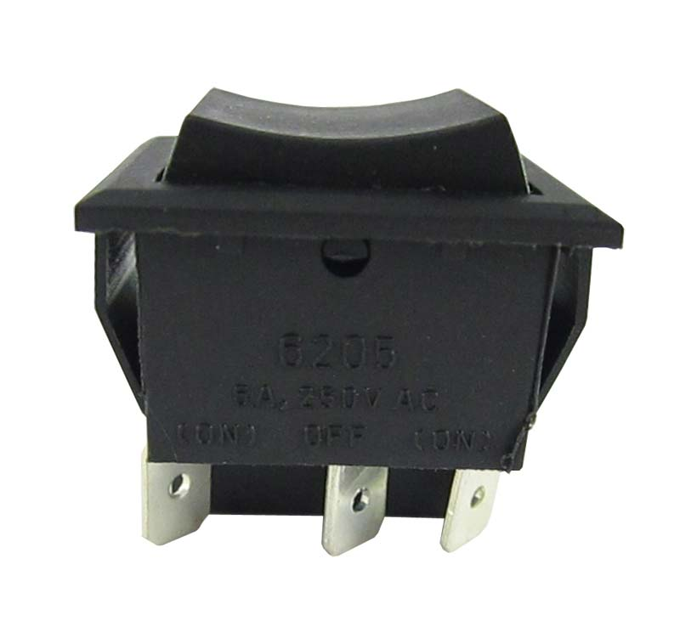
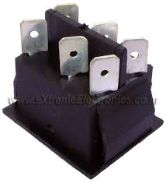
DPDT Switch

Slide 4
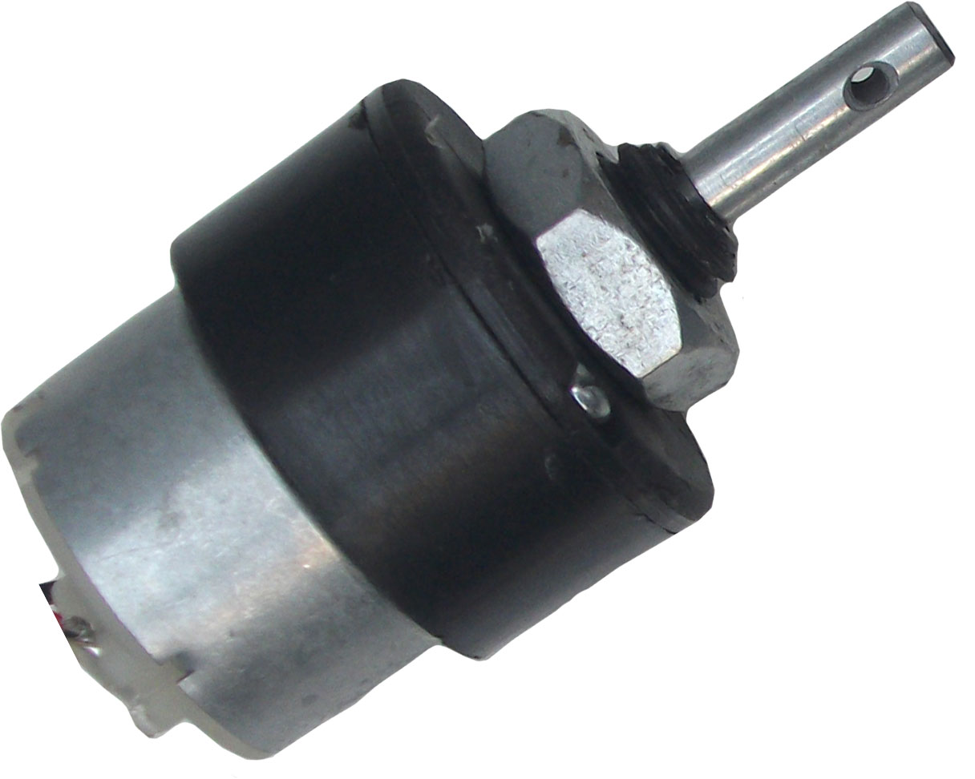
Geared DC Motor

Slide 5
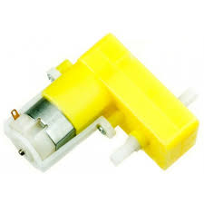
DO NOT BUY THIS MOTOR

Slide 6
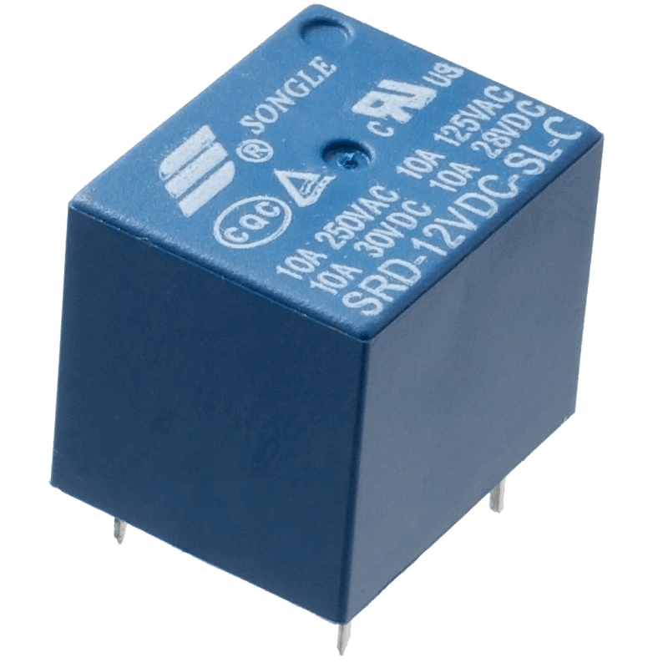
12V Relay

Slide 7
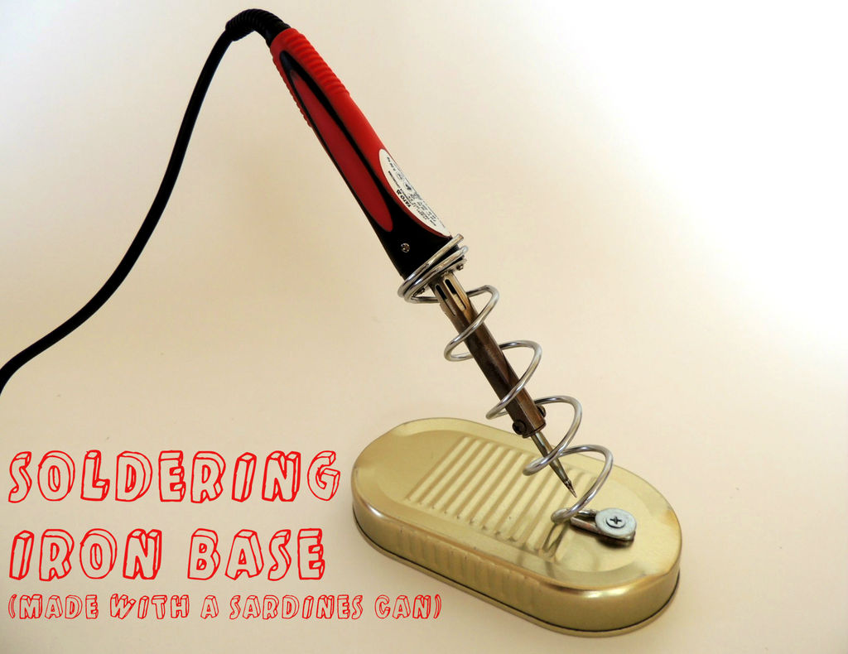

Soldering Iron with Stand

Slide 8
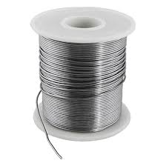

Soldering Flux
Soldering Wire

Slide 9
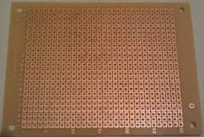
Zero PCB

Slide 10
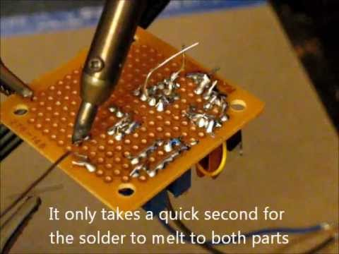

Slide 11
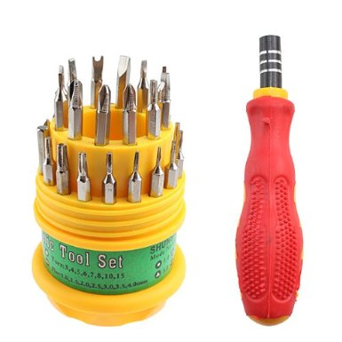

Slide 12
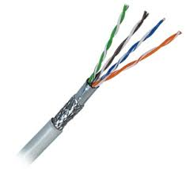
CAT 5E LAN Cable Without Connector

Slide 13

12V Sealed Lead Acid Battery

Slide 14
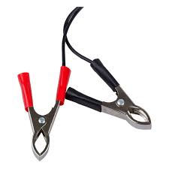
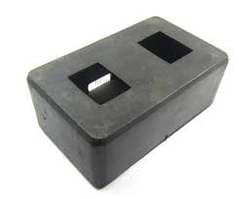
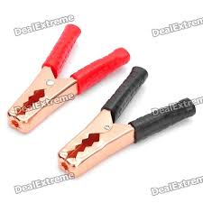
Remote Box and Battery Clips

Slide 15
THANKYOU

